Slide 1
Piano Recognition
Ryan Thorpe / Haoxuan yang
December 7, 2016
EENG507

Slide 2
Agenda
Topic: Aims and Assumptions
Previous Work
Approach
Experiments and Results
Achievements, limitations and future work
References

Slide 3

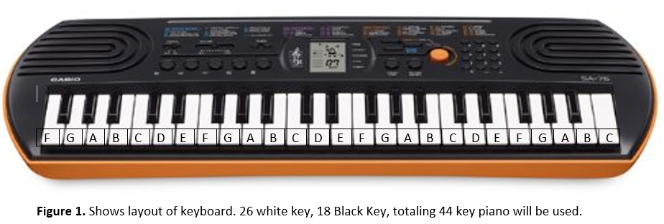
Topic - Aims and Assumptions
Develop a computer vision system that can assist in playing the piano
Similar to the game, Guitar Hero
The piano displays notes to be played on an LCD screen
The code is able to read the music notes and display the key to be played
http://vignette4.wikia.nocookie.net/guitarhero/images/c/c4/Guitar-hero.jpg/revision/latest?cb=20140917150037

Slide 4
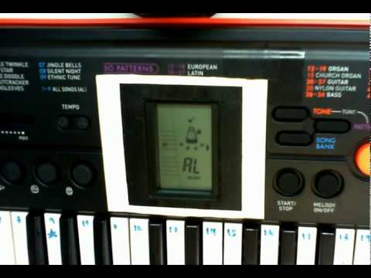
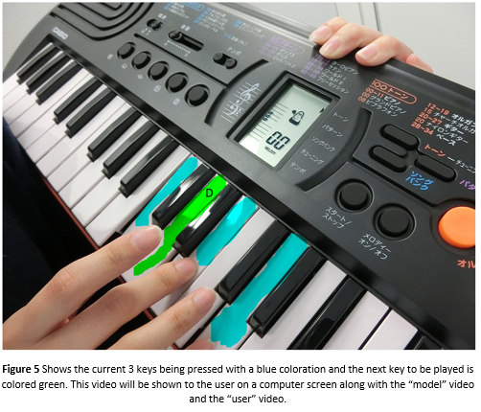
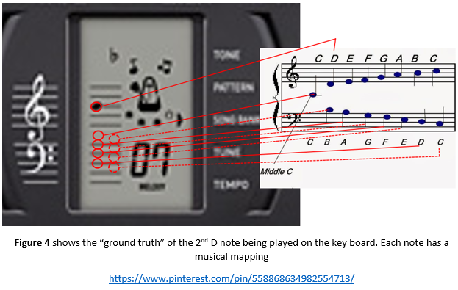
Topic - Aims and Assumptions
The Code is broken into two parts
The Music Reader
The Key Highlighter
The Finger detector

Slide 5
Agenda
Topic: Aims and Assumptions
Previous Work
Approach
Experiments and Results
Achievements, limitations and future work
References

Slide 6
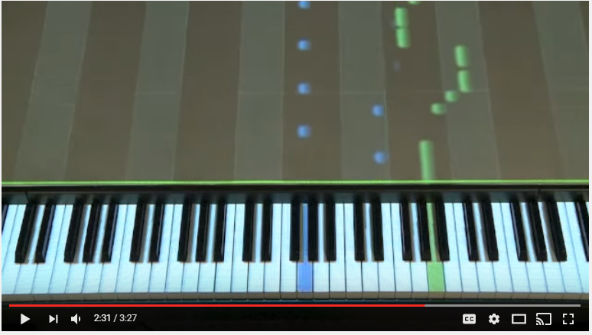
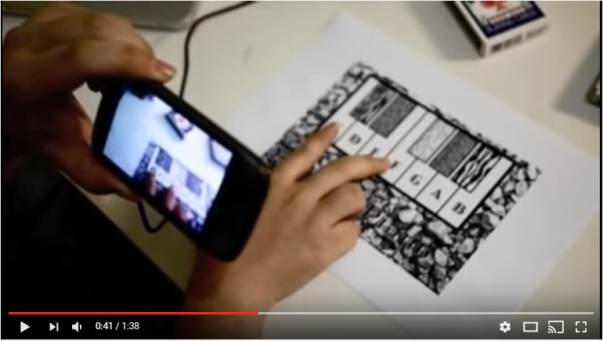
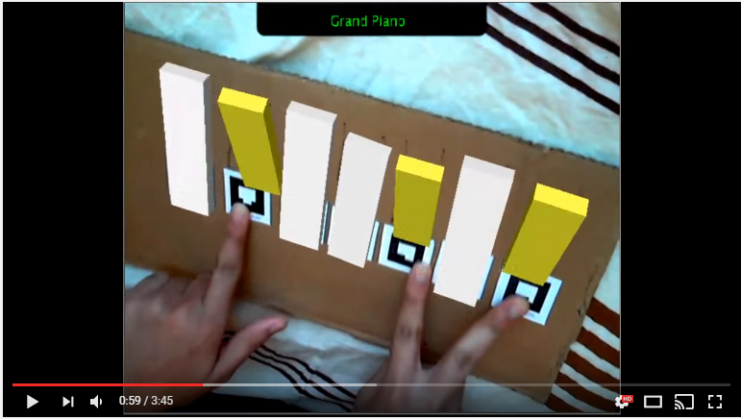
Previous Work
The are many types of Augmented Reality Piano players
Use projectors
Have varying degrees of user feedback
1. TAP Augmented Piano
3. Mobile Piano Player
https://www.youtube.com/watch?v=Abstj0PdkW0&t=120s
https://www.youtube.com/watch?v=Pp-MwmSbOYo
https://www.youtube.com/watch?v=kfnd2wnb1Ec
2. Augmented Reality Music Composition

Slide 7
Agenda
Topic: Aims and Assumptions
Previous Work
Approach
Experiments and Results
Achievements, limitations and future work
References

Slide 8
Approach - Music Reader
Wanted code to read the LCD screen and output the corresponding key number(s)
There are 26 white keys, 18 black keys
They are numbered 1-44
Used MATLAB to process is as follows
Calibrate on-screen music notes
Read Video
Recognize LCD screen Area
Use Hough Lines to find corners
Loop to read video every second
Read Video
Use corners to make orthophoto showing region of interest
Threshold to reveal “note blobs”
Calculate x,y centers of blobs
Output key number to be pressed

Slide 9
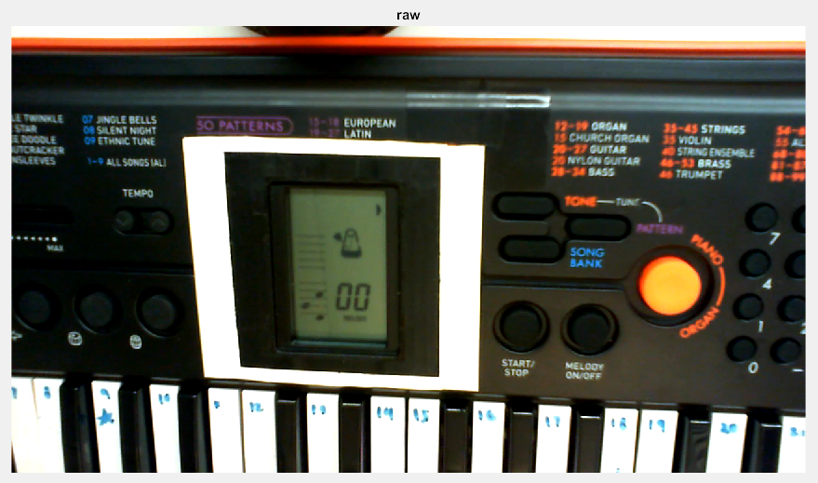
Calibration Procedure
Reads raw image
Three notes are pressed from the start
These are the calibration notes

Slide 10
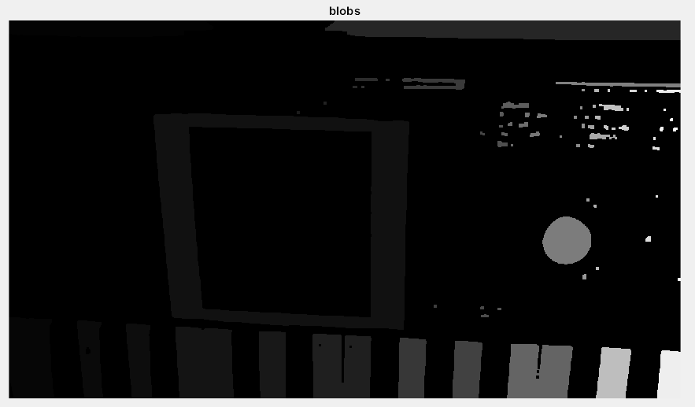
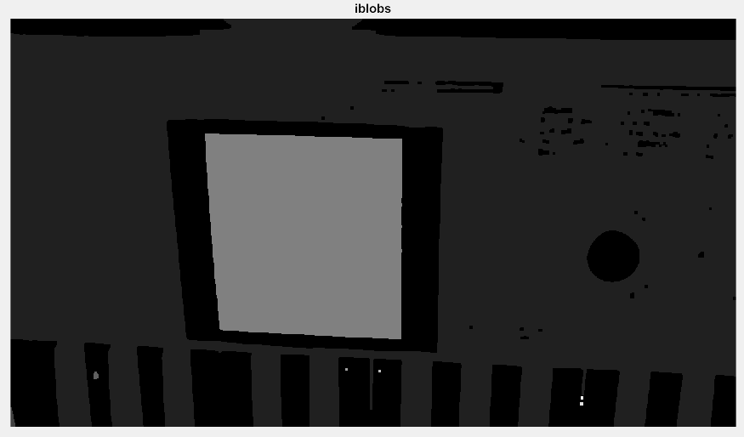

Calibration Procedure
Using techniques from the CCC labs the black region inside white window will be picked out
We want to find the 4 corners of this region

Slide 11
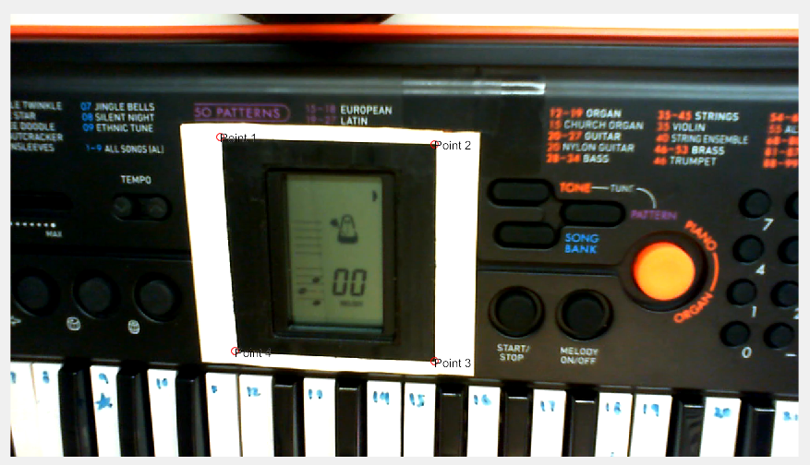
Calibration Procedure
The simplified region mask allows for robust corner point calculation
Issues arose from using the LCD screen because of it’s rounded edges and sunken position
Corners were calculated by finding the hough lines and their intersection points

Slide 12
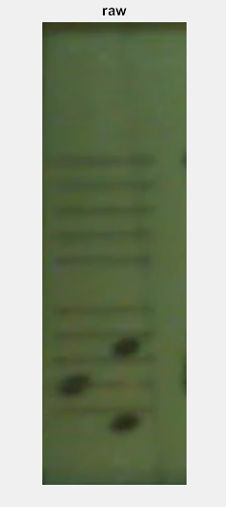
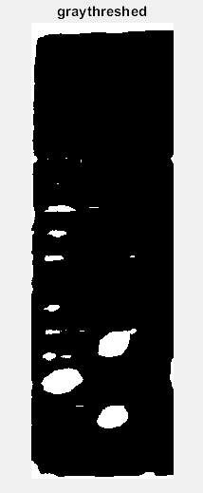

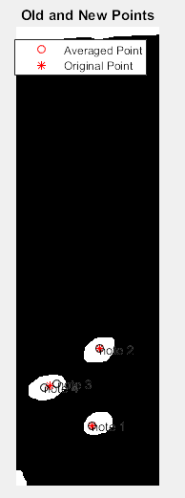
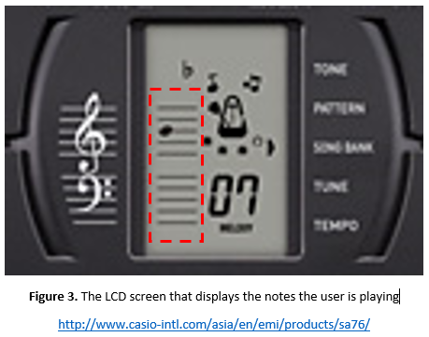
Calibration Procedure
With the corner points found use known dimensions of white window to make ortho photo of region of interest

Slide 13
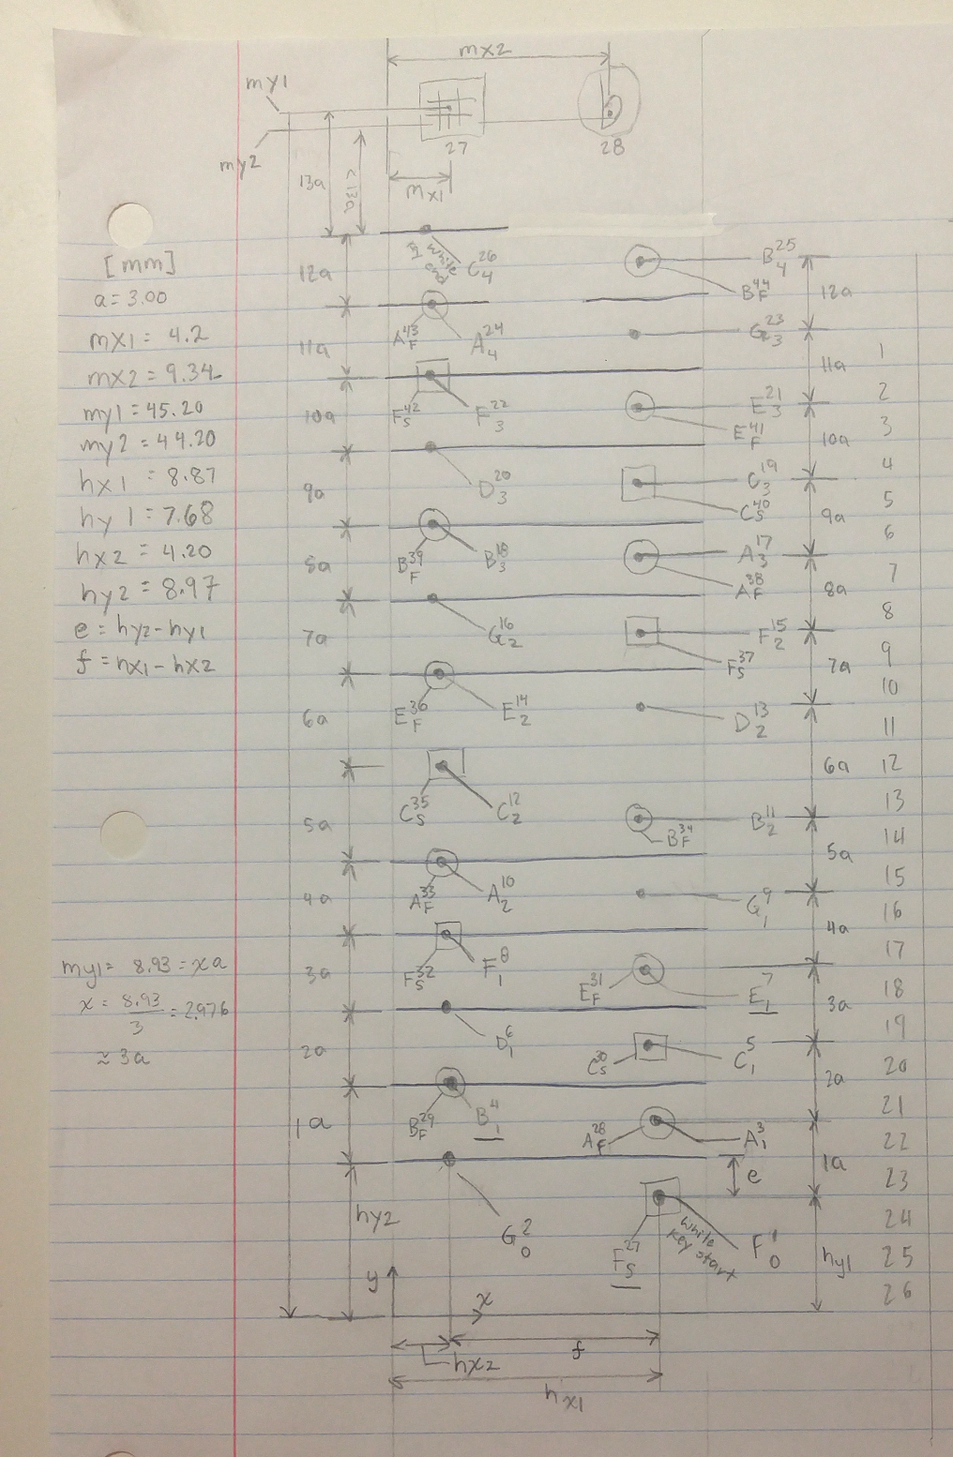
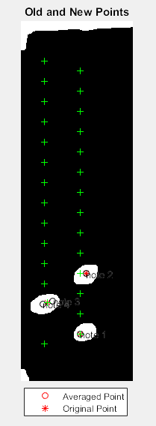
Calibration Procedure
Note 1 is assigned as the origin
Based off this the locations of the other 27 notes are calculated in a lookup table
The pixel locations of notes 4 and 7 are compared to this lookup table to see if calibration was a success
The main outputs from calibrate() are:
Note lookup table
Orthophoto corners
Note 7
Note 4
The position of Key 1 becomes the LCD’s origin (0,0)

Slide 14
Approach - Music Reader
Wanted code to read the LCD screen and output the corresponding key number(s)
There are 26 white keys, 18 black keys
They are numbered 1-44
Used MATLAB to process is as follows
Calibrate on-screen music notes
Read Video
Recognize LCD screen Area
Use Hough Lines to find corners
Loop to read video every second
Read Video
Use corners to make orthophoto showing region of interest
Threshold to reveal “note blobs”
Calculate x,y centers of blobs
Output key number to be pressed

Slide 15
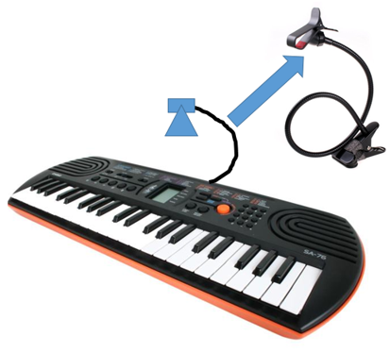
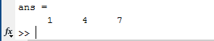
Reading Music in Video Stream
With orthophoto corners we can go straight to a “normal” region of interest every frame.
Key numbers are calculated every second and stored
This array will be used in the second part of the project
The Key Highlighting
Key Highlighting

Slide 16
Video of Ode to Joy
Key numbers
18
19
20
0
16
18
17
17
0
20
18
16
17
17
16
15 seconds of Ode to Joy!

Slide 17
Approach - Key Highlighter
What we have:
Time notes(table) from the video reader
Video from the bad piano player
What we want:
Highlight keys being pressed
Highlight keys which should be pressed
How??

Slide 18
Approach - Key Highlighter
Using array of piano key numbers to highlight the corresponding key for a song or the user
There are 26 white keys, 18 black keys
They are numbered 1-44
Used MATLAB to process is as follows
Use hough lines to find corners of keyboard
Read the first frame of the video
Adjust the threshold to find right corners of keyboard
Calculate the position of each key and save them into the database
Use piano key array to highlight appropriate piano key
Get the input from the time notes→ convert to notes in frame
Find the position of keys from database
Highlight them with rectangles in different color

Slide 19
Approach - Key Highlighter
Watch DEMO

Slide 20
Approach - Finger Detector
Two ways to know which keys are being pressed by the user
Detect the small notes on the screen
Limited camera quality problem (too far from the camera)
Bad lighting condition problem (such as reflection on the screen)
Hand gesture(Finger tips)
Color threshold
Lighting condition problem : restrict the threshold
Background problem (almost the same color with my hand) → multiple boundaries : use region of interest
Find peaks
Only can find minima on the boundary when using “findpeaks” function : use “flipdim” now and then flip back in the future.
Multiple peaks : pick the highest one (that’s the fingertip !!!)
NOT A GOOD WAY !

Slide 21
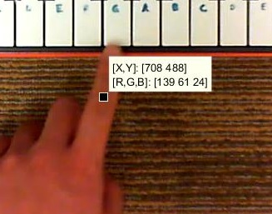
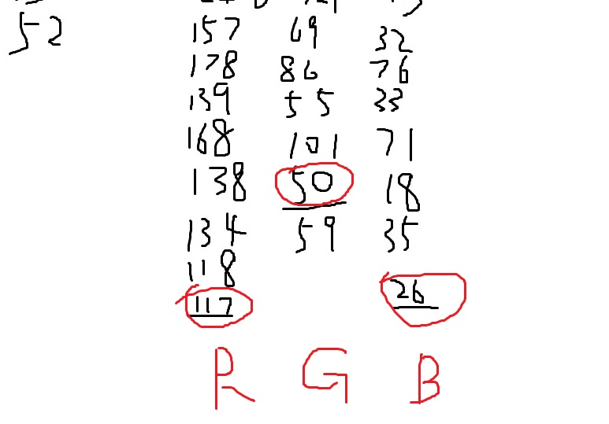
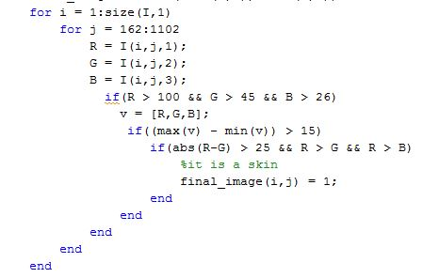
Color Threshold
Collect color data of hand from different frames and generate the threshold
But this is far from enough because this still cannot get rid of the background (the colors look like the same)

Slide 22


Bad Result
The result after erosion and dilation is so bad that blobs are connected and is hard to get rid of the part we want.

Slide 23
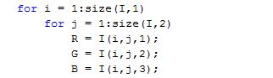
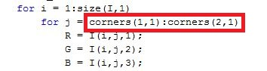
Color Threshold Improved
Remember we get the position of four corners of the keyboard, so we can apply limitation
Limitation

Slide 24

Color Threshold Improved

Slide 25
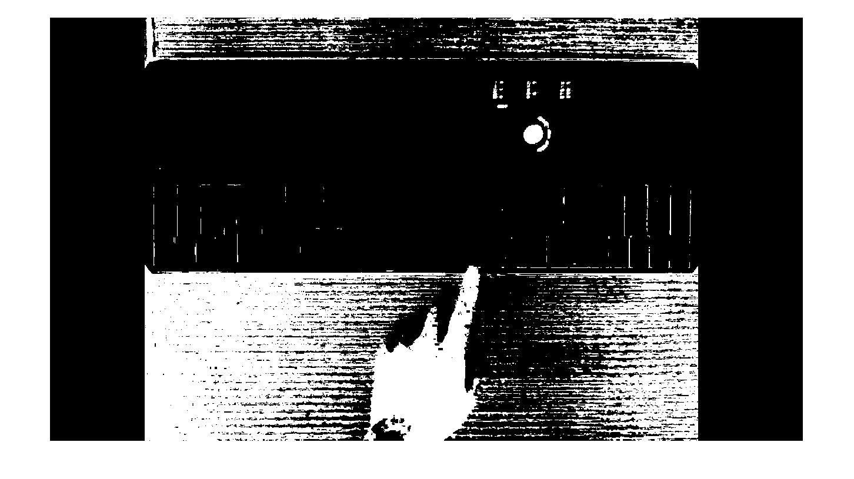

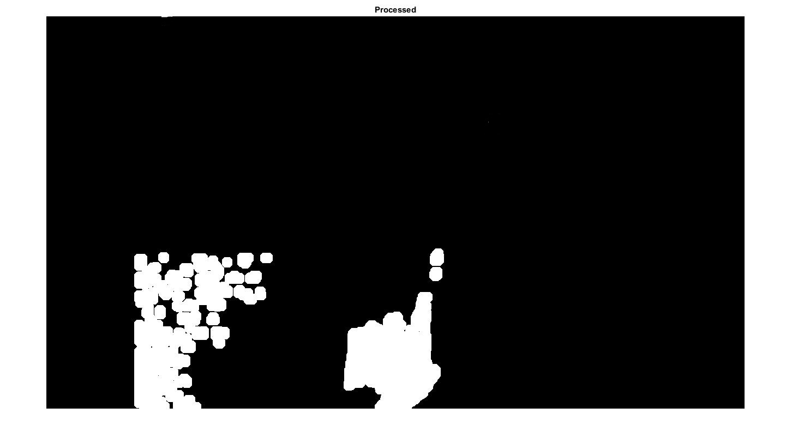
Finding peaks
Use region of interest to ignore multiple boundaries
After color threshold
After erosion
After removing small regions
After dilation

Slide 26
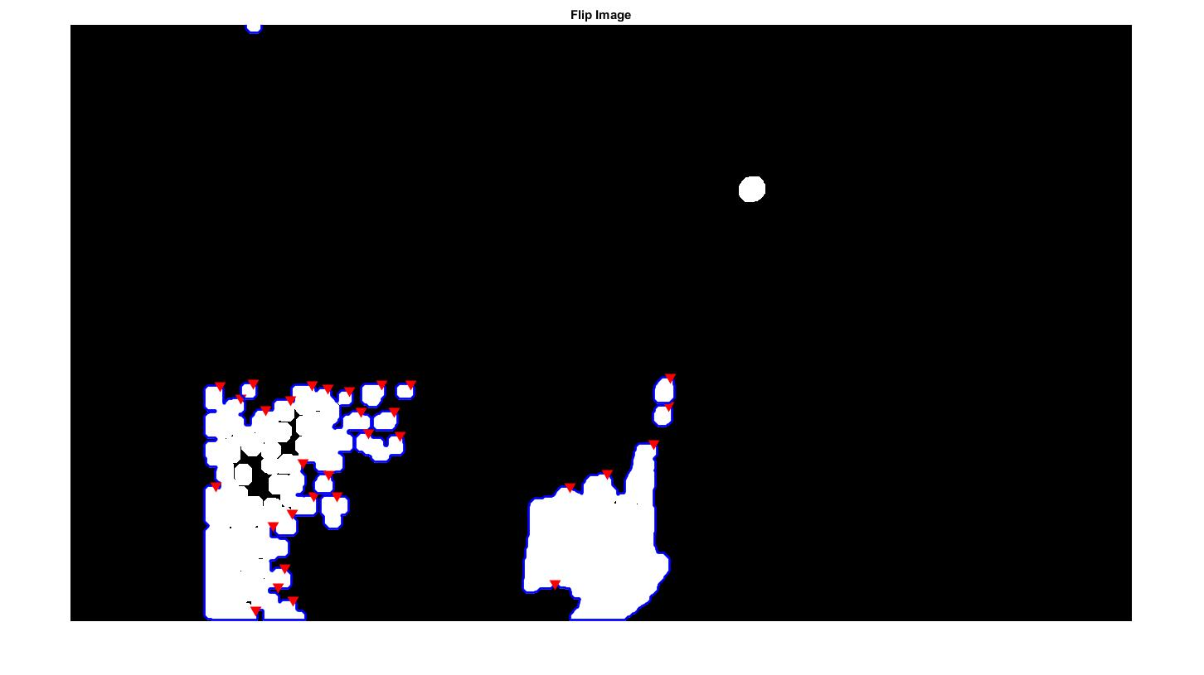
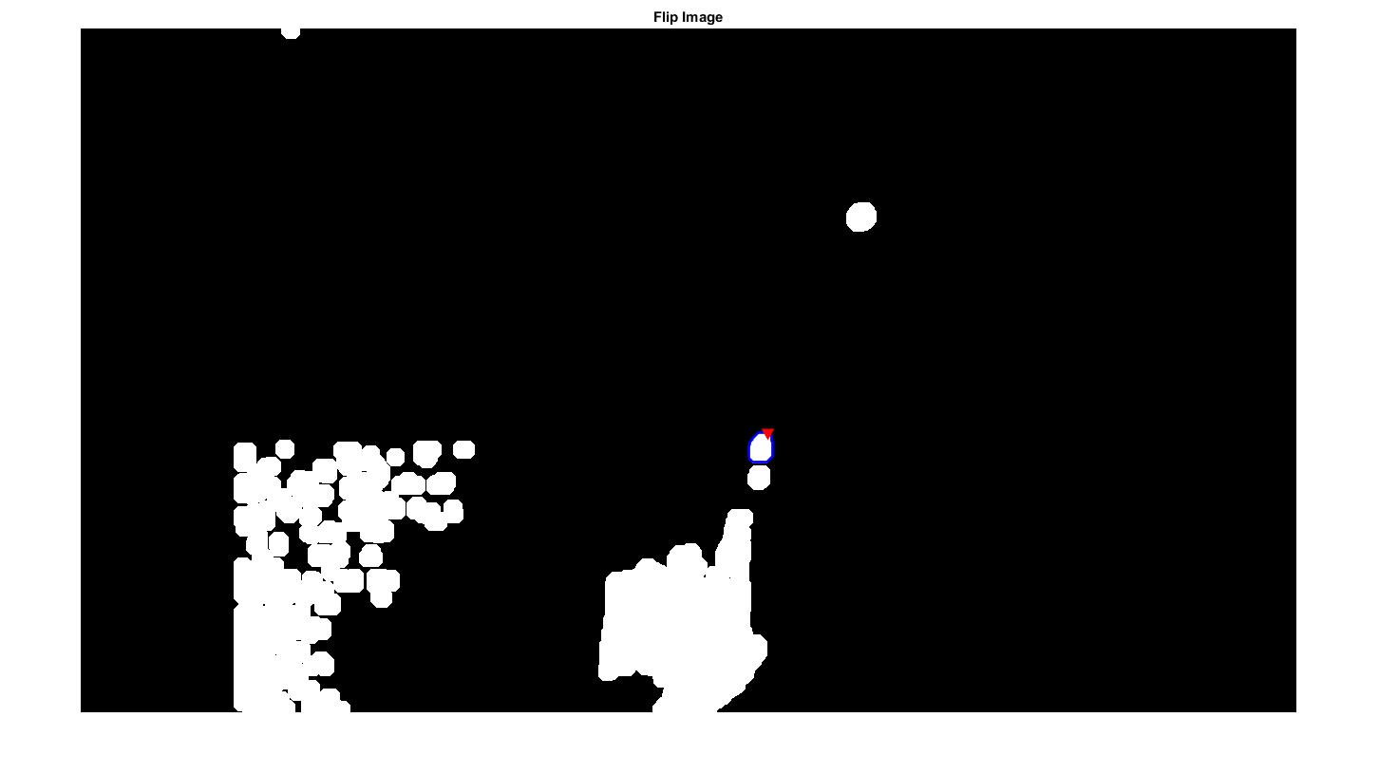

Finding peaks
Pick the highest peaks on the boundary, and determine if it is on the keyboard

Slide 27
Agenda
Topic: Aims and Assumptions
Previous Work
Approach
Experiments and Results
Achievements, limitations and future work
References

Slide 28
Results
Watch Videos!

Slide 29
Agenda
Topic: Aims and Assumptions
Previous Work
Approach
Experiments and Results
Achievements, limitations and future work
References

Slide 30
Achievements and Limitations
Succeeded at extracting piano key numbers from a video
Was not able to robustly do this in real time
Changes in lighting as well as changes in camera position often cause changes in calibration parameters
Succeeded at highlighting the correct piano key based off the LCD screen
Was unable to do this real time
MATLAB may struggle with this due to computational speed limitations
Were unable to program a reliable GUI

Slide 31
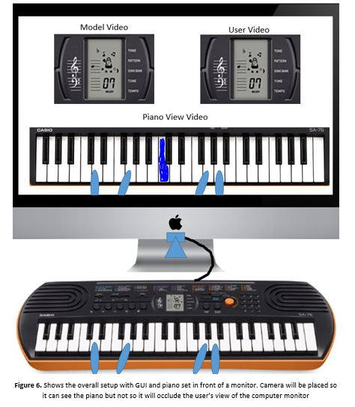
Future Work
Make program run in real time
Complete GUI
Modify code to use a piano with no modifications (no white window)
Use HD camera to allow recording from further distance
Learn piano the “old-fashioned” way

Slide 32
Questions?
Any Questions?

